Slide 1
Hash

Slide 2
Search :
Linear search O(n)
Binary search O(lg n)
Is there an efficient approach by O(1)?

Slide 3
We are looking for “efficiency“…!
اگرچه ذخیره سازی داده در آرایه به زمانO(1) نیاز دارد، جستجو در آن حداقلO(log n) زمان می برد. این زمان به نظر کوچک است، اما برای یک مجموعه داده بزرگ، می تواند مشکلات زیادی ایجاد کند و این به نوبه خود، ساختار داده Array را ناکارآمد می کند.
بنابراین اکنون به دنبال ساختار داده ای هستیم که بتواند داده ها را ذخیره کرده و در زمان ثابت، یعنی در زمان O(1) فرایند جستجو انجام شود. به این ترتیب ساختار داده Hashing معرفی می شود. با معرفی ساختار داده Hash ، اکنون می توان به راحتی داده ها را در زمان ثابت ذخیره کرد و در زمان ثابت نیز آنها را بازیابی نمود.

Slide 4
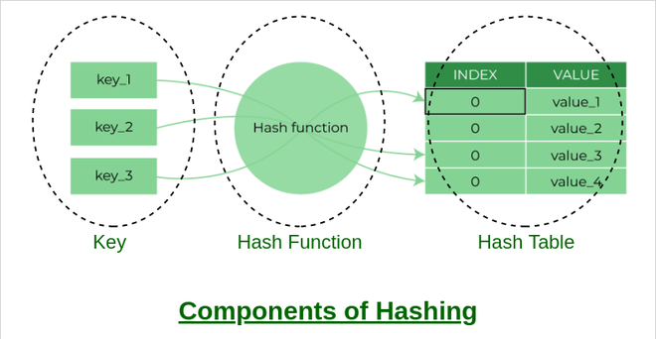
What is Hashing?
Hashing به فرآیند تولید یک خروجی با اندازه ثابت از ورودی با اندازه متغیر با استفاده از فرمول های ریاضی معروف به توابع hash اشاره دارد. این تکنیک یک شاخص یا مکان را برای ذخیره یک آیتم در یک ساختار داده تعیین می کند.

Slide 5
Components of Hashing
hashing به طور عمده دارای سه بخش می باشد:
Key: A Key can be anything string or integer which is fed as input in the hash function the technique that determines an index or location for storage of an item in a data structure.
Hash Function: The hash function receives the input key and returns the index of an element in an array called a hash table. The index is known as the hash index.
Hash Table: Hash table is a data structure that maps keys to values using a special function called a hash function. Hash stores the data in an associative manner in an array where each data value has its own unique index.

Slide 7
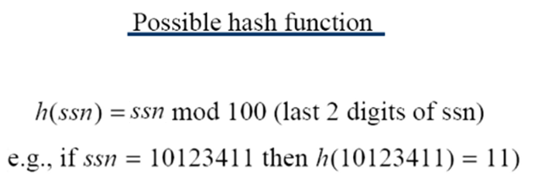
Example 1
فرض کنید کلیدها شامل اعداد امنیتی 8 رقمی هستند:

Slide 8
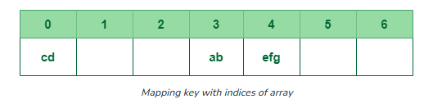
Example 2
Suppose we have a set of strings {“ab”, “cd”, “efg”} and we would like to store it in a table.
Hash function: sum(string) mod 7
“ab” in 3 mod 7 = 3,
“cd” in 7 mod 7 = 0, and
“efg” in 18 mod 7 = 4.
تکنیک بالا ما را قادر می سازد مکان یک رشته معین را با استفاده از یک تابع هش ساده محاسبه کنیم و به سرعت مقدار ذخیره شده در آن مکان را پیدا کنیم. بنابراین ایده هش کردن یک راه عالی برای ذخیره (کلید، مقدار) جفت داده در یک جدول به نظر می رسد.

Slide 9
What happens if 'ba' is inserted?

Slide 10
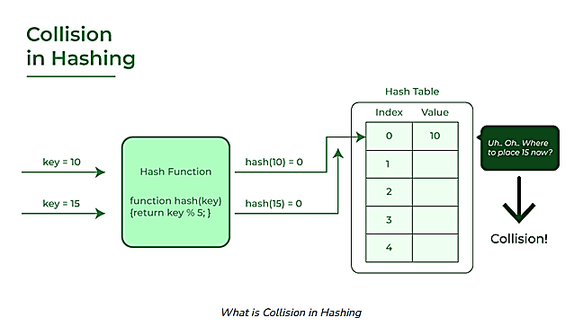

Slide 11
What is collision?
The hashing process generates a small number for a big key, so there is a possibility that two keys could produce the same value. The situation where the newly inserted key maps to an already occupied, and it must be handled using some collision handling technology.

Slide 12
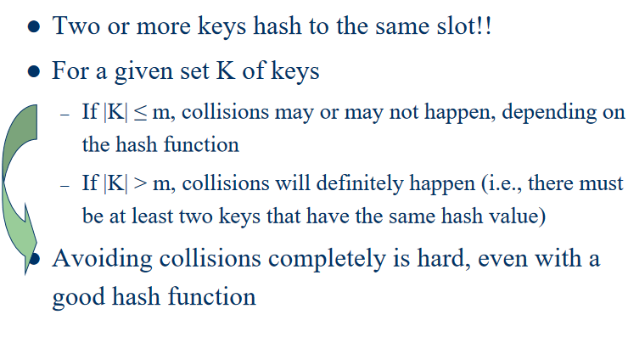
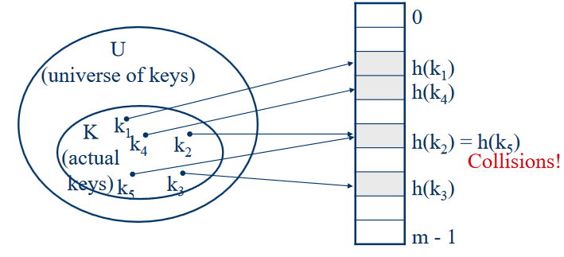

Slide 13
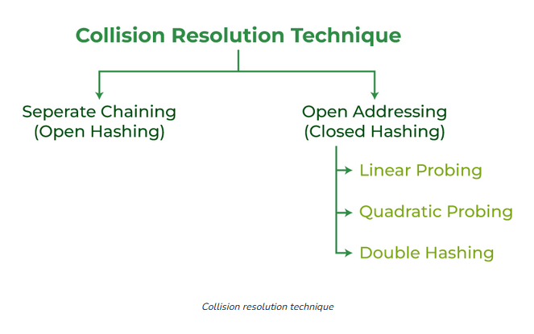

Slide 14
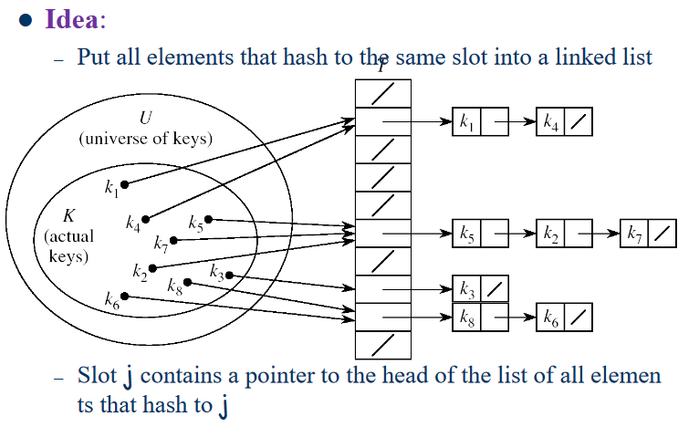
Separate Chaining

Slide 15
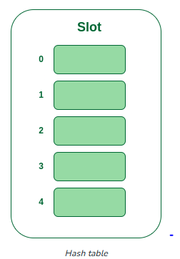
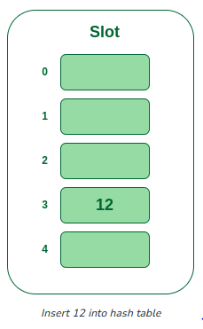
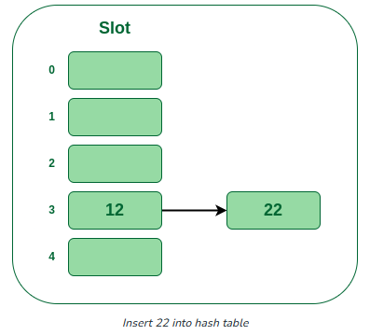
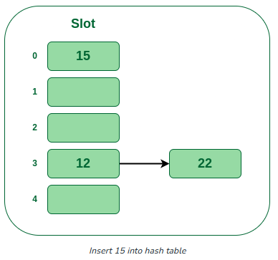
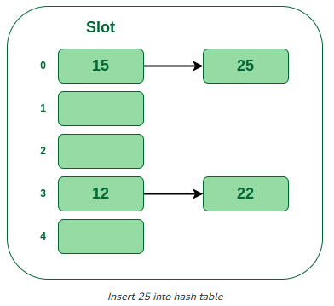
Example
Hash function = key % 5,
Elements = 12, 15, 22, 25 and 37.

Slide 16
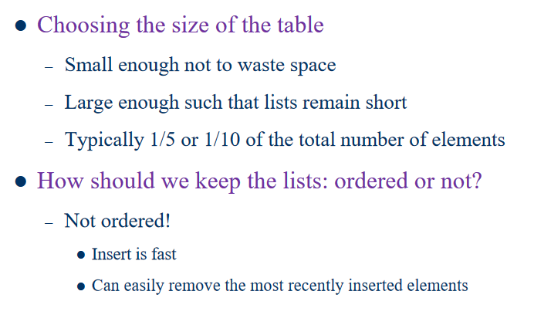
Separate Chaining

Slide 17
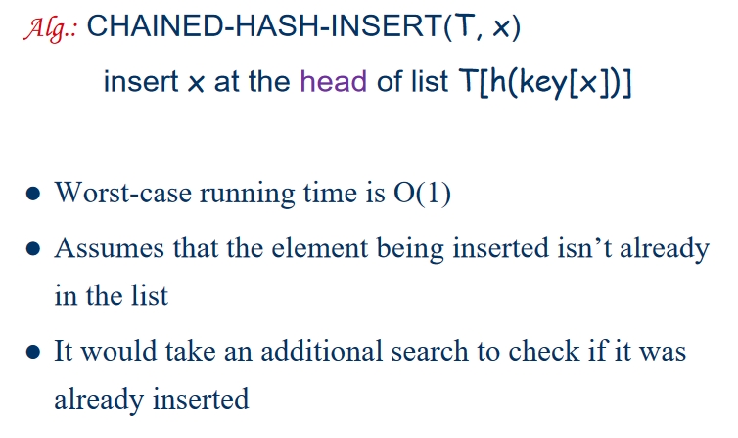
Separate Chaining

Slide 18
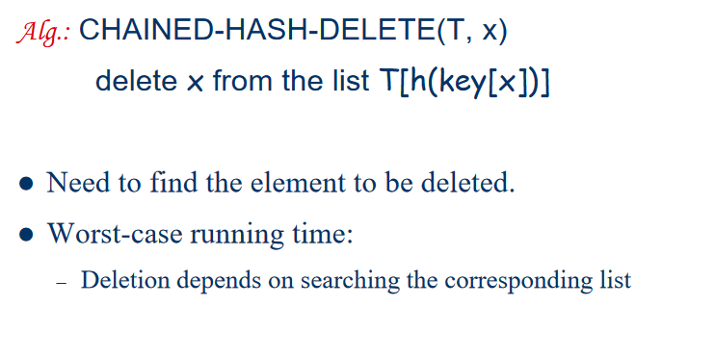
Separate Chaining

Slide 19
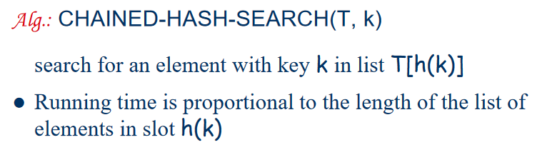
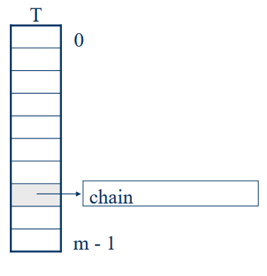
Separate Chaining

Slide 20
Open Addressing
در آدرس دهی باز، همه عناصر در خود جدول هش ذخیره می شوند.
هر ورودی جدول شامل یک رکورد یاNIL است.
هنگام جستجوی یک عنصر، خانه های جدول را یکی یکی بررسی می کنیم تا عنصر مورد نظر پیدا شود یا مشخص شود که عنصر در جدول نیست.

Slide 21
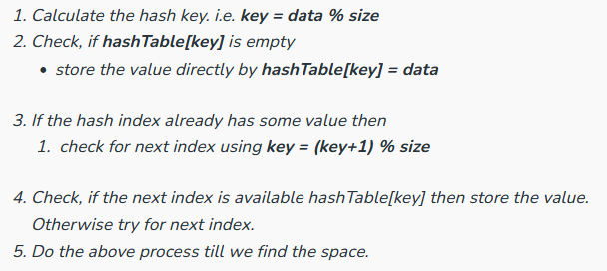
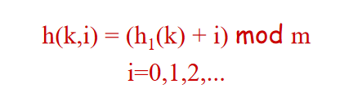
Open Addressing – Linear probing
در این روش، جدول هش به صورت متوالی جستجو می شود که از محل اصلی هش شروع می شود. اگر مکان مورد نظر قبلاً اشغال شده باشد، مکان بعدی را بررسی می کنیم و همچنان ادامه می دهیم.

Slide 22
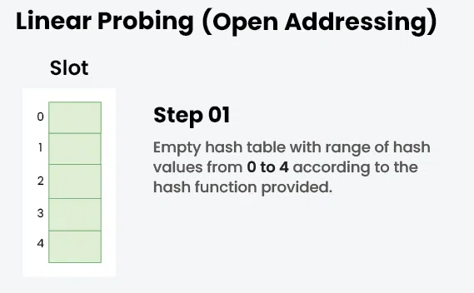
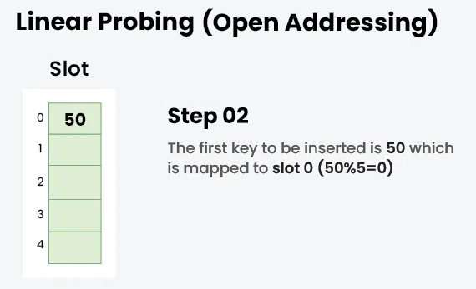
Open Addressing – Linear probing

Slide 23
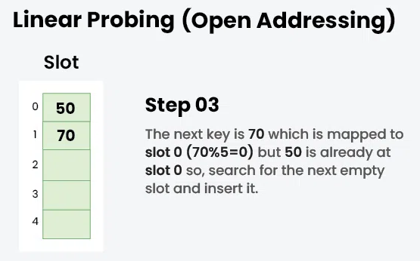
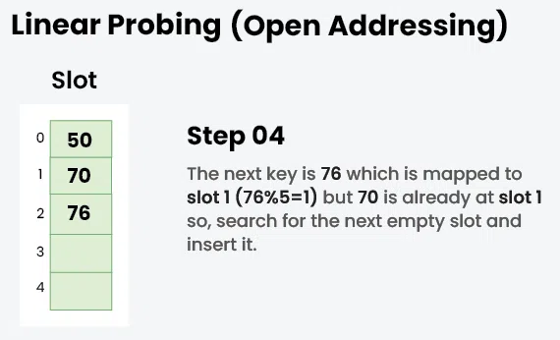
Open Addressing – Linear probing

Slide 24
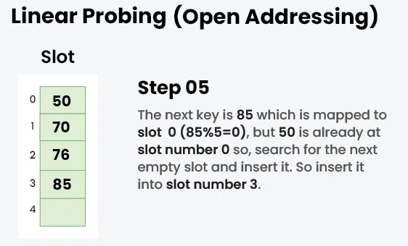
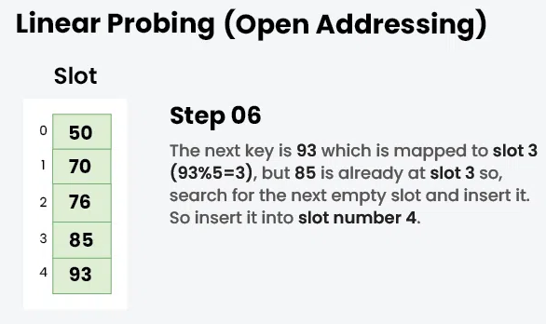
Open Addressing – Linear probing

Slide 25
Linear Probing
The easiest method to probe the bins of the hash table is to search forward linearly
Assume we are inserting into bin k:
If bin k is empty, we occupy it
Otherwise, check bin k + 1, k + 2, and so on, until an empty bin is found
If we reach the end of the array, we start at the front (bin 0)

Slide 26
Linear Probing
Consider a hash table with M = 16 bins
Given a 3-digit hexadecimal number:
The least-significant digit is the primary hash function (bin)
Example: for 6B72A₁₆ , the initial bin is A

Slide 27
Insertion
Insert these numbers into this initially empty hash table:
19A, 207, 3AD, 488, 5BA, 680, 74C, 826, 946, ACD, B32, C8B, DBE, E9C
0 | 1 | 2 | 3 | 4 | 5 | 6 | 7 | 8 | 9 | A | B | C | D | E | F

Slide 28
Example
Start with the first four values:
19A, 207, 3AD, 488
0 | 1 | 2 | 3 | 4 | 5 | 6 | 7 | 8 | 9 | A | B | C | D | E | F

Slide 29
Example
Start with the first four values:
19A, 207, 3AD, 488
0 | 1 | 2 | 3 | 4 | 5 | 6 | 7 | 8 | 9 | A | B | C | D | E | F
 |  |  |  |  |  |  | 207 | 488 |  | 19A |  |  | 3AD

Slide 30
Example
Next we must insert 5BA
0 | 1 | 2 | 3 | 4 | 5 | 6 | 7 | 8 | 9 | A | B | C | D | E | F
 |  |  |  |  |  |  | 207 | 488 |  | 19A |  |  | 3AD

Slide 31
Example
Next we must insert 5BA
Bin A is occupied
We search forward for the next empty bin
0 | 1 | 2 | 3 | 4 | 5 | 6 | 7 | 8 | 9 | A | B | C | D | E | F
 |  |  |  |  |  |  | 207 | 488 |  | 19A | 5BA |  | 3AD

Slide 32
Example
Next we are adding 680, 74C, 826
0 | 1 | 2 | 3 | 4 | 5 | 6 | 7 | 8 | 9 | A | B | C | D | E | F
 |  |  |  |  |  |  | 207 | 488 |  | 19A | 5BA |  | 3AD

Slide 33
Example
Next we are adding 680, 74C, 826
All the bins are empty—simply insert them
0 | 1 | 2 | 3 | 4 | 5 | 6 | 7 | 8 | 9 | A | B | C | D | E | F
680 |  |  |  |  |  | 826 | 207 | 488 |  | 19A | 5BA | 74C | 3AD

Slide 34
Example
Next, we must insert 946
0 | 1 | 2 | 3 | 4 | 5 | 6 | 7 | 8 | 9 | A | B | C | D | E | F
680 |  |  |  |  |  | 826 | 207 | 488 |  | 19A | 5BA | 74C | 3AD

Slide 35
Example
Next, we must insert 946
Bin 6 is occupied
The next empty bin is 9
0 | 1 | 2 | 3 | 4 | 5 | 6 | 7 | 8 | 9 | A | B | C | D | E | F
680 |  |  |  |  |  | 826 | 207 | 488 | 946 | 19A | 5BA | 74C | 3AD

Slide 36
Example
Next, we must insert ACD
0 | 1 | 2 | 3 | 4 | 5 | 6 | 7 | 8 | 9 | A | B | C | D | E | F
680 |  |  |  |  |  | 826 | 207 | 488 | 946 | 19A | 5BA | 74C | 3AD

Slide 37
Example
Next, we must insert ACD
Bin D is occupied
The next empty bin is E
0 | 1 | 2 | 3 | 4 | 5 | 6 | 7 | 8 | 9 | A | B | C | D | E | F
680 |  |  |  |  |  | 826 | 207 | 488 | 946 | 19A | 5BA | 74C | 3AD | ACD

Slide 38
Example
Next, we insert B32
0 | 1 | 2 | 3 | 4 | 5 | 6 | 7 | 8 | 9 | A | B | C | D | E | F
680 |  |  |  |  |  | 826 | 207 | 488 | 946 | 19A | 5BA | 74C | 3AD | ACD

Slide 39
Example
Next, we insert B32
Bin 2 is unoccupied
0 | 1 | 2 | 3 | 4 | 5 | 6 | 7 | 8 | 9 | A | B | C | D | E | F
680 |  | B32 |  |  |  | 826 | 207 | 488 | 946 | 19A | 5BA | 74C | 3AD | ACD

Slide 40
Example
Next, we insert C8B
0 | 1 | 2 | 3 | 4 | 5 | 6 | 7 | 8 | 9 | A | B | C | D | E | F
680 |  | B32 |  |  |  | 826 | 207 | 488 | 946 | 19A | 5BA | 74C | 3AD | ACD

Slide 41
Example
Next, we insert C8B
Bin B is occupied
The next empty bin is F
0 | 1 | 2 | 3 | 4 | 5 | 6 | 7 | 8 | 9 | A | B | C | D | E | F
680 |  | B32 |  |  |  | 826 | 207 | 488 | 946 | 19A | 5BA | 74C | 3AD | ACD | C8B

Slide 42
Example
Next, we insert D59
0 | 1 | 2 | 3 | 4 | 5 | 6 | 7 | 8 | 9 | A | B | C | D | E | F
680 |  | B32 |  |  |  | 826 | 207 | 488 | 946 | 19A | 5BA | 74C | 3AD | ACD | C8B

Slide 43
Example
Next, we insert D59
Bin 9 is occupied
The next empty bin is 1
0 | 1 | 2 | 3 | 4 | 5 | 6 | 7 | 8 | 9 | A | B | C | D | E | F
680 | D59 | B32 |  |  |  | 826 | 207 | 488 | 946 | 19A | 5BA | 74C | 3AD | ACD | C8B

Slide 44
Example
Finally, insert E9C
0 | 1 | 2 | 3 | 4 | 5 | 6 | 7 | 8 | 9 | A | B | C | D | E | F
680 | D59 | B32 |  |  |  | 826 | 207 | 488 | 946 | 19A | 5BA | 74C | 3AD | ACD | C8B

Slide 45
Example
Finally, insert E9C
Bin C is occupied
The next empty bin is 3
0 | 1 | 2 | 3 | 4 | 5 | 6 | 7 | 8 | 9 | A | B | C | D | E | F
680 | D59 | B32 | E9C |  |  | 826 | 207 | 488 | 946 | 19A | 5BA | 74C | 3AD | ACD | C8B

Slide 46
Example
Having completed these insertions:
The load factor is λ = 14/16 = 0.875
The average number of probes is 38/14 ≈ 2.71
0 | 1 | 2 | 3 | 4 | 5 | 6 | 7 | 8 | 9 | A | B | C | D | E | F
680 | D59 | B32 | E93 |  |  | 826 | 207 | 488 | 946 | 19A | 5BA | 74C | 3AD | ACD | C8B

Slide 47
Searching
Testing for membership is similar to insertions:
Start at the appropriate bin, and searching forward until
The item is found,
An empty bin is found, or
We have traversed the entire array
The third case will only occur if the hash table is full (load factor of 1)
0 | 1 | 2 | 3 | 4 | 5 | 6 | 7 | 8 | 9 | A | B | C | D | E | F
680 | D59 | B32 | E93 |  |  | 826 | 207 | 488 | 946 | 19A | 5BA | 74C | 3AD | ACD | C8B

Slide 48
Searching
Searching for C8B
0 | 1 | 2 | 3 | 4 | 5 | 6 | 7 | 8 | 9 | A | B | C | D | E | F
680 | D59 | B32 | E93 |  |  | 826 | 207 | 488 | 946 | 19A | 5BA | 74C | 3AD | ACD | C8B

Slide 49
Searching
Searching for C8B
Examine bins B, C, D, E, F
The value is found in Bin F
0 | 1 | 2 | 3 | 4 | 5 | 6 | 7 | 8 | 9 | A | B | C | D | E | F
680 | D59 | B32 | E93 |  |  | 826 | 207 | 488 | 946 | 19A | 5BA | 74C | 3AD | ACD | C8B

Slide 50
Searching
Searching for 23E
0 | 1 | 2 | 3 | 4 | 5 | 6 | 7 | 8 | 9 | A | B | C | D | E | F
680 | D59 | B32 | E93 |  |  | 826 | 207 | 488 | 946 | 19A | 5BA | 74C | 3AD | ACD | C8B

Slide 51
Searching
Searching for 23E
Search bins E, F, 0, 1, 2, 3, 4
The last bin is empty; therefore, 23E is not in the table
0 | 1 | 2 | 3 | 4 | 5 | 6 | 7 | 8 | 9 | A | B | C | D | E | F
680 | D59 | B32 | E93 | × |  | 826 | 207 | 488 | 946 | 19A | 5BA | 74C | 3AD | ACD | C8B

Slide 52
Erasing
We cannot simply remove elements from the hash table
0 | 1 | 2 | 3 | 4 | 5 | 6 | 7 | 8 | 9 | A | B | C | D | E | F
680 | D59 | B32 | E93 |  |  | 826 | 207 | 488 | 946 | 19A | 5BA | 74C | 3AD | ACD | C8B

Slide 53
Erasing
We cannot simply remove elements from the hash table
For example, consider erasing 3AD
0 | 1 | 2 | 3 | 4 | 5 | 6 | 7 | 8 | 9 | A | B | C | D | E | F
680 | D59 | B32 | E93 |  |  | 826 | 207 | 488 | 946 | 19A | 5BA | 74C | 3AD | ACD | C8B

Slide 54
Erasing
We cannot simply remove elements from the hash table
For example, consider erasing 3AD
If we just erase it, it is now an empty bin
By our algorithm, we cannot find ACD, C8B and D59
0 | 1 | 2 | 3 | 4 | 5 | 6 | 7 | 8 | 9 | A | B | C | D | E | F
680 | D59 | B32 | E93 |  |  | 826 | 207 | 488 | 946 | 19A | 5BA | 74C |  | ACD | C8B

Slide 55
Erasing
Instead, we must attempt to fill the empty bin
0 | 1 | 2 | 3 | 4 | 5 | 6 | 7 | 8 | 9 | A | B | C | D | E | F
680 | D59 | B32 | E93 |  |  | 826 | 207 | 488 | 946 | 19A | 5BA | 74C |  | ACD | C8B

Slide 56
Erasing
Instead, we must attempt to fill the empty bin
We can move ACD into the location
0 | 1 | 2 | 3 | 4 | 5 | 6 | 7 | 8 | 9 | A | B | C | D | E | F
680 | D59 | B32 | E93 |  |  | 826 | 207 | 488 | 946 | 19A | 5BA | 74C | ACD | ACD | C8B

Slide 57
Erasing
Now we have another bin to fill
0 | 1 | 2 | 3 | 4 | 5 | 6 | 7 | 8 | 9 | A | B | C | D | E | F
680 | D59 | B32 | E93 |  |  | 826 | 207 | 488 | 946 | 19A | 5BA | 74C | ACD |  | C8B

Slide 58
Erasing
Now we have another bin to fill
We can move ACD into the location
0 | 1 | 2 | 3 | 4 | 5 | 6 | 7 | 8 | 9 | A | B | C | D | E | F
680 | D59 | B32 | E93 |  |  | 826 | 207 | 488 | 946 | 19A | 5BA | 74C | ACD | C8B | C8B

Slide 59
Erasing
Now we must attempt to fill the bin at F
We cannot move 680
0 | 1 | 2 | 3 | 4 | 5 | 6 | 7 | 8 | 9 | A | B | C | D | E | F
680 | D59 | B32 | E93 |  |  | 826 | 207 | 488 | 946 | 19A | 5BA | 74C | ACD | C8B

Slide 60
Erasing
Now we must attempt to fill the bin at F
We cannot move 680
We can, however, move D59
0 | 1 | 2 | 3 | 4 | 5 | 6 | 7 | 8 | 9 | A | B | C | D | E | F
680 | D59 | B32 | E93 |  |  | 826 | 207 | 488 | 946 | 19A | 5BA | 74C | ACD | C8B | D59

Slide 61
Erasing
At this point, we cannot move B32 or E93 and the next bin is empty
We are finished
0 | 1 | 2 | 3 | 4 | 5 | 6 | 7 | 8 | 9 | A | B | C | D | E | F
680 |  | B32 | E93 |  |  | 826 | 207 | 488 | 946 | 19A | 5BA | 74C | ACD | C8B | D59

Slide 62
Erasing
Suppose we delete 207
0 | 1 | 2 | 3 | 4 | 5 | 6 | 7 | 8 | 9 | A | B | C | D | E | F
680 |  | B32 | E93 |  |  | 826 | 207 | 488 | 946 | 19A | 5BA | 74C | ACD | C8B | D59

Slide 63
Erasing
Suppose we delete 207
Cannot move 488
0 | 1 | 2 | 3 | 4 | 5 | 6 | 7 | 8 | 9 | A | B | C | D | E | F
680 |  | B32 | E93 |  |  | 826 |  | 488 | 946 | 19A | 5BA | 74C | ACD | C8B | D59

Slide 64
Erasing
Suppose we delete 207
We could move 946 into Bin 7
0 | 1 | 2 | 3 | 4 | 5 | 6 | 7 | 8 | 9 | A | B | C | D | E | F
680 |  | B32 | E93 |  |  | 826 | 946 | 488 | 946 | 19A | 5BA | 74C | ACD | C8B | D59

Slide 65
Erasing
Suppose we delete 207
We cannot move either the next five entries
0 | 1 | 2 | 3 | 4 | 5 | 6 | 7 | 8 | 9 | A | B | C | D | E | F
680 |  | B32 | E93 |  |  | 826 | 946 | 488 |  | 19A | 5BA | 74C | ACD | C8B | D59

Slide 66
Erasing
Suppose we delete 207
We cannot move either the next five entries
0 | 1 | 2 | 3 | 4 | 5 | 6 | 7 | 8 | 9 | A | B | C | D | E | F
680 |  | B32 | E93 |  |  | 826 | 946 | 488 | D59 | 19A | 5BA | 74C | ACD | C8B | D59

Slide 67
Erasing
Suppose we delete 207
We cannot fill this bin with 680, and the next bin is empty
We are finished
0 | 1 | 2 | 3 | 4 | 5 | 6 | 7 | 8 | 9 | A | B | C | D | E | F
680 |  | B32 | E93 |  |  | 826 | 946 | 488 | D59 | 19A | 5BA | 74C | ACD | C8B

Slide 68


Open Addressing – Quadratic Probing
این روش یک طرح آدرس دهی باز در برنامه نویسی کامپیوتری برای حل برخورد هش در جداول هش است. کاوش درجه دوم با گرفتن شاخص هش اصلی و افزودن مقادیر متوالی یک چند جمله ای درجه دوم دلخواه عمل می کند تا زمانی که یک شکاف باز پیدا شود.

Slide 69
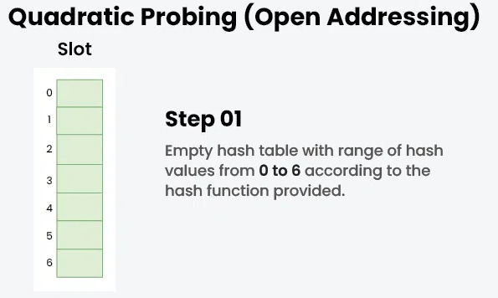
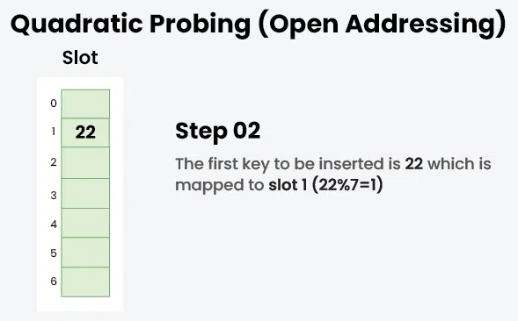
Open Addressing – Quadratic Probing

Slide 70
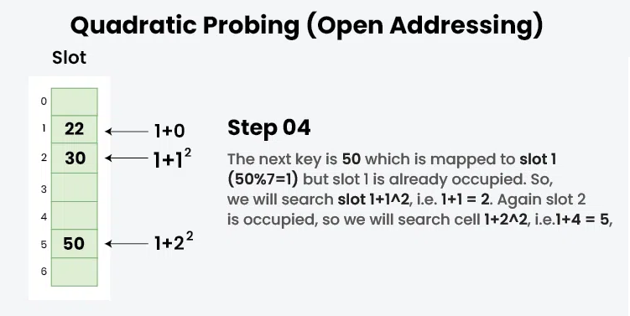
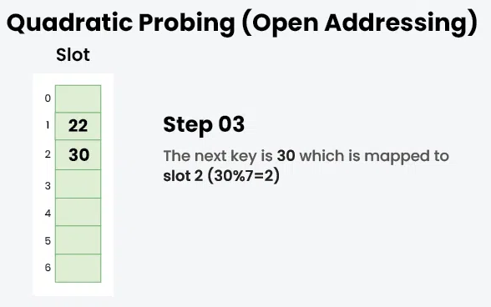
Open Addressing – Quadratic Probing

Slide 71
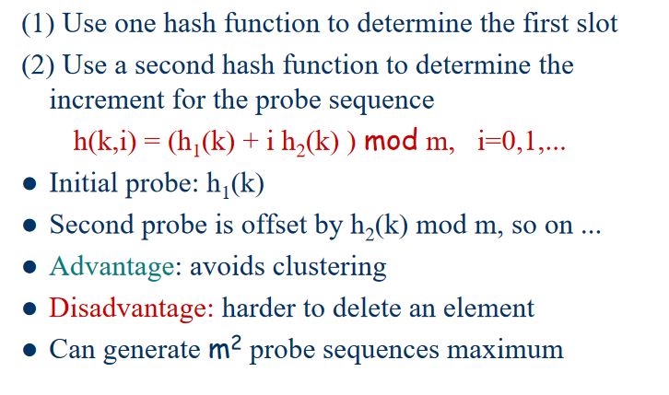
Open Addressing – Double Hashing

Slide 72
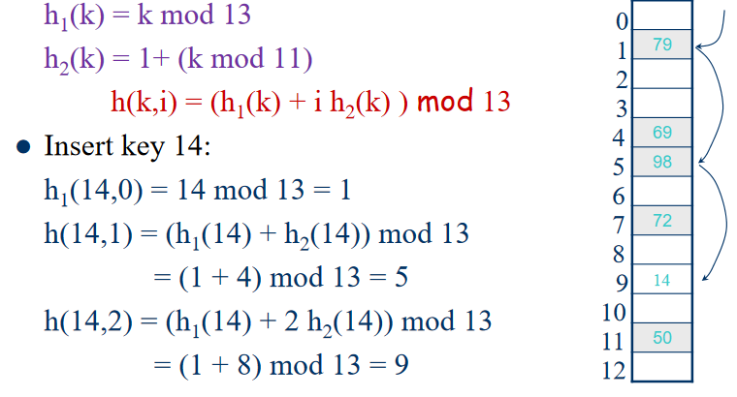
Open Addressing – Double Hashing

Slide 73
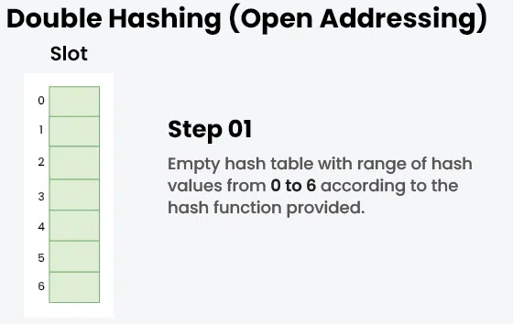
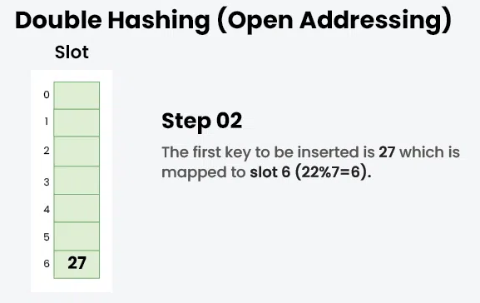
Open Addressing – Double Hashing
Example: Insert the keys 27, 43, 692, 72 into the Hash Table of size 7. where first hash-function is h1​(k) = k mod 7 and second hash-function is h2(k) = 1 + (k mod 5)

Slide 74
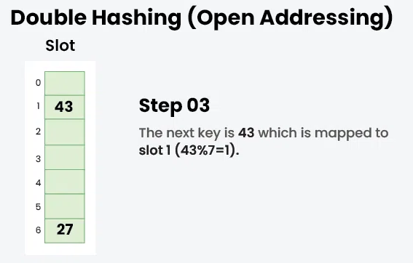
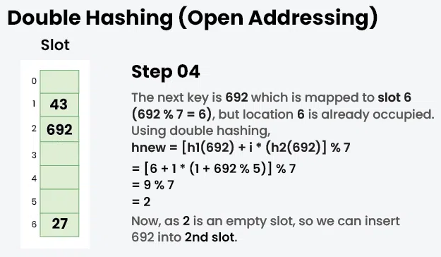
Open Addressing – Double Hashing
Example: Insert the keys 27, 43, 692, 72 into the Hash Table of size 7. where first hash-function is h1​(k) = k mod 7 and second hash-function is h2(k) = 1 + (k mod 5)

Slide 75
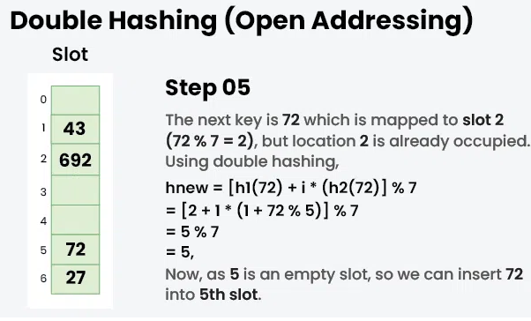
Open Addressing – Double Hashing
Example: Insert the keys 27, 43, 692, 72 into the Hash Table of size 7. where first hash-function is h1​(k) = k mod 7 and second hash-function is h2(k) = 1 + (k mod 5)

Slide 76
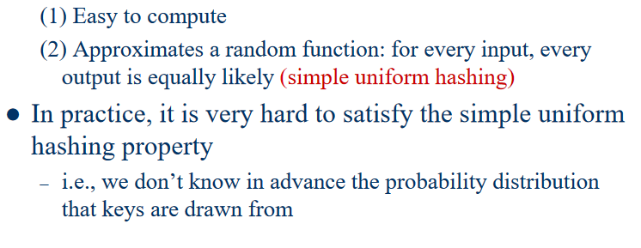
What makes a good hash function?

Slide 77
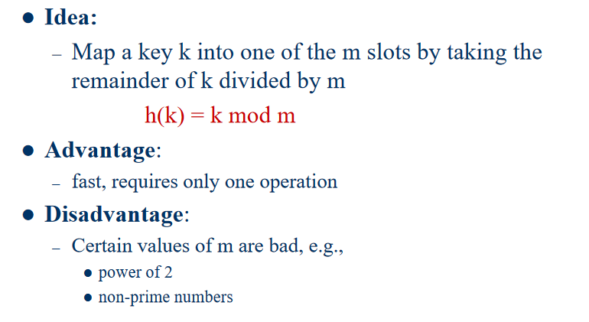
The Division Method

Slide 78
What is meant by Load Factor in Hashing?
فاکتور بار (load factor) جدول هش را می توان به عنوان تعداد آیتم هایی که در جدول هش وجودر دارد تقسیم بر اندازه جدول هش تعریف کرد. این فاکتور، پارامتر تعیین کننده ای است که وقتی می خواهیم تابع هش قبلی را دوباره هش کنیم یا می خواهیم عناصر بیشتری به جدول هش موجود اضافه کنیم استفاده می شود.
این فاکتور به ما در تعیین کارایی تابع هش کمک می کند، یعنی به ما می گوید که آیا تابع هش مورد استفاده کلیدها را به طور یکنواخت در جدول هش توزیع می کند یا خیر.

